Slide 1




AUDISANKARA COLLEGE OF ENGINEERING & TECHNOLOGY::GUDUR
Department of Master of Computer Applications
BUILDING SEARCH ENGINE USING MACHINE LEARNING TECHNIQUE
Submitted by: Guide By:
Y. Varshitha Mr. A.Hemantha Kumar, MCA ,M.Tech (Ph.D)
(22G21F0117) Associate Professor ,
Department of MCA
Dept of MCA
1

Slide 2


ABSTRACT
Building Search Engine using Machine Learning Technique The web is the huge and most extravagant wellspring of data. To recover the information from the World Wide Web, Search Engines are commonly utilized. Search engines provide a simple interface for searching for user query and displaying results in the form of the web address of the relevant web page but using traditional search engines has become very challenging to obtain suitable information. This paper proposed a search engine using Machine Learning technique that will give more relevant web pages at top for user queries.

Slide 3
INTRODUCTION
World Wide Web is actually a web of individual systems and servers which are connected with different technology and methods. Every site comprises the heaps of site pages that are being made and sent on the server. So, if a user needs something, then he or she needs to type a keyword. Keyword is a set of words extracted from user search input. Search input given by a user may be syntactically incorrect. Here comes the actual need for search engines. Search engines provide you a simple interface to search user queries and display the results. Web crawlers help in collecting data about a website and the links related to them. We are only using web crawlers for collecting data and information from WWW and storing it in our database.

Slide 4
EXISTING SYSTEM
Information retrieval is to retrieve the information resources that we are interested in or extract whatever information we need.
Information Retrieval (IR) may deal with the organization, storage, retrieval and evaluation of information from documents, particularly textual information. But we cannot give the ranks to those documents.

Slide 5
DISADVANTAGES EXISTING SYSTEM
Information retrieval will be very difficult in large numbers of texts in a document.
Difficult to identify the important concepts or topic in a collection of documents.
The explicit rankings are always difficult to obtain or even not available in many documents.

Slide 6
PROPOSED SYSTEM
In this paper author is using machine learning algorithms called SVM and XGBOOST to predict search result of given query and building search engine with machine learning algorithms.
To train this algorithm author is using website data and then this data will be converted to numeric vector called TFIDF (term frequency inverse document frequency). TFIDF vector contains average frequency of each words.
The proposed search engine is very useful for finding out more relevant URLs for given keywords.

Slide 7
ADVANTAGES PROPOSED SYSTEM
We will build a search engine which gives the web address of the most relevant web page at the top of the search result, according to user queries.
The main focus of our system is to build a search engine to discover the utmost suitable web address for the given keyword by using machine learning techniques for increasing accuracy compared to available search engines.

Slide 8
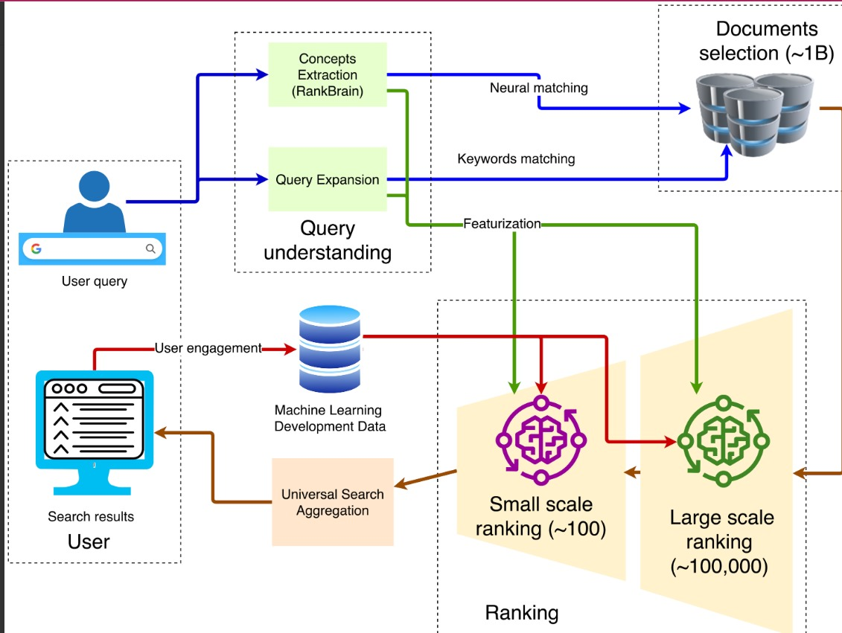
SYSTEM ARCHITECTURE
Fig: Architecture

Slide 9
MODULES
ADMIN MODULE: Admin can login to application using username and password as admin and then accept or activate new users registration and then train SVM and XGBOOST algorithm.
MANAGER MODULE: manager can login to application by using username and password as Manager and Manager and then upload dataset to application.
NEW USER SIGNUP: using this module new user can signup with the application.
USER LOGIN: user can login to application and then perform search by giving query.

Slide 10
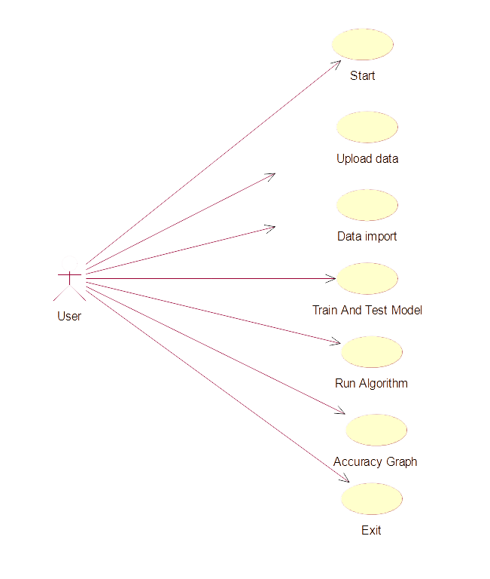
SYSTEM DESIGN
Fig: Use Case Diagram
Dept of MCA
10

Slide 11
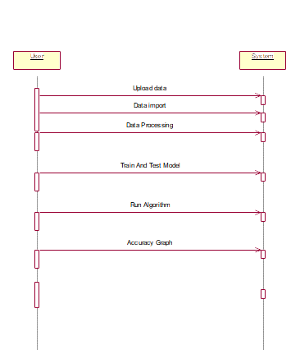
SYSTEM DESIGN
Fig: Sequence Diagram

Slide 12
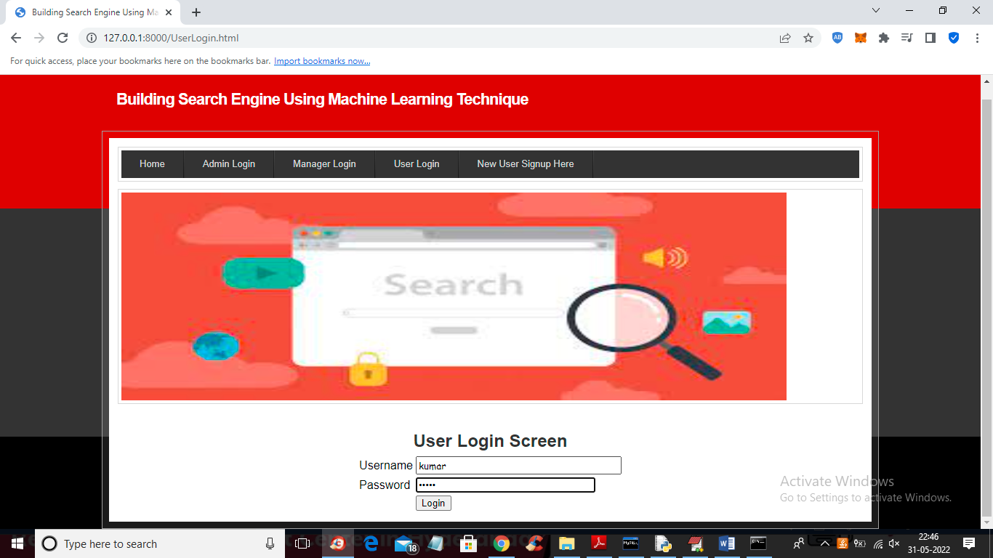
OUTPUT SCREENS
USER LOGIN SCREEN
Fig: USER LOGIN SCREEN

Slide 13

OUTPUT SCREENS
ADMIN LOGIN SCREEN
Fig: Admin Login Screen

Slide 14
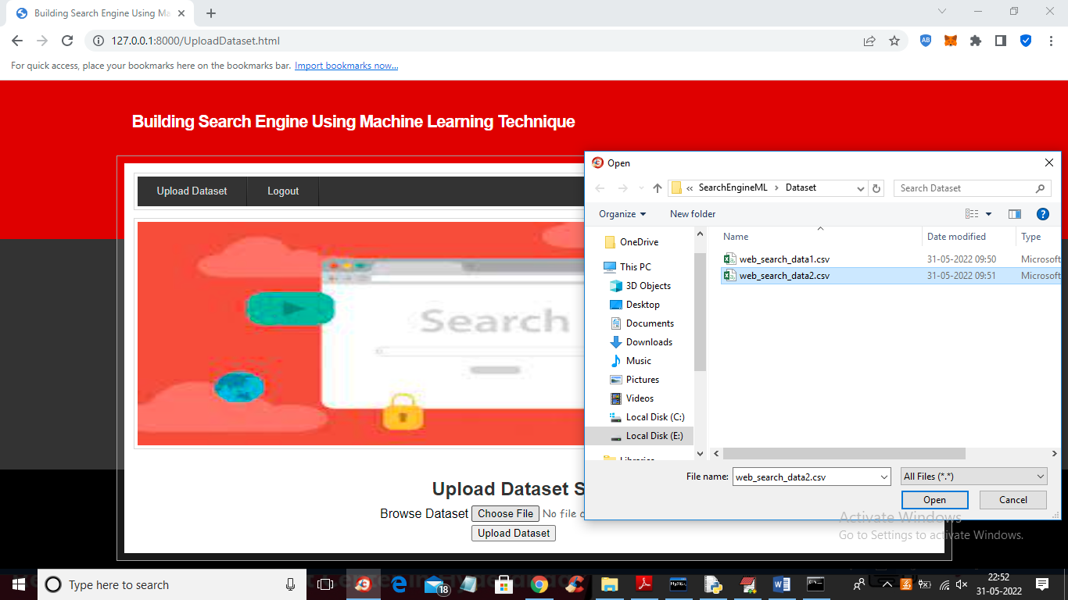
OUTPUT SCREENS
UPLOAD DATASET
Fig: Upload Dataset
Dept of MCA
14

Slide 15
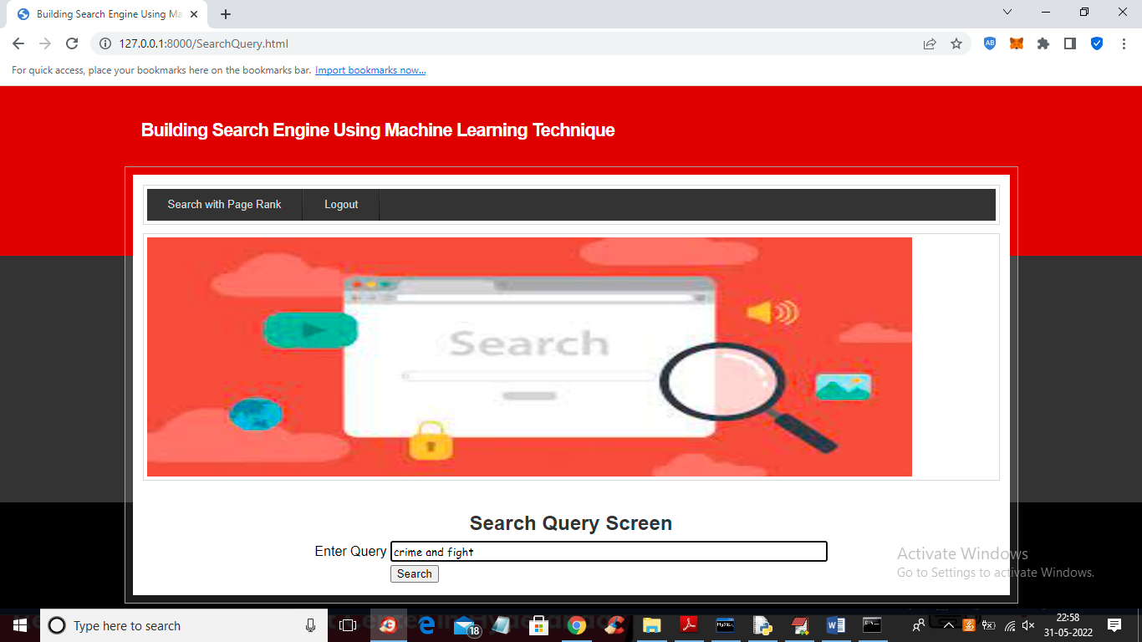
OUTPUT SCREENS
SEARCH QUERY SCREEN
Fig: Search Query Screen

Slide 16
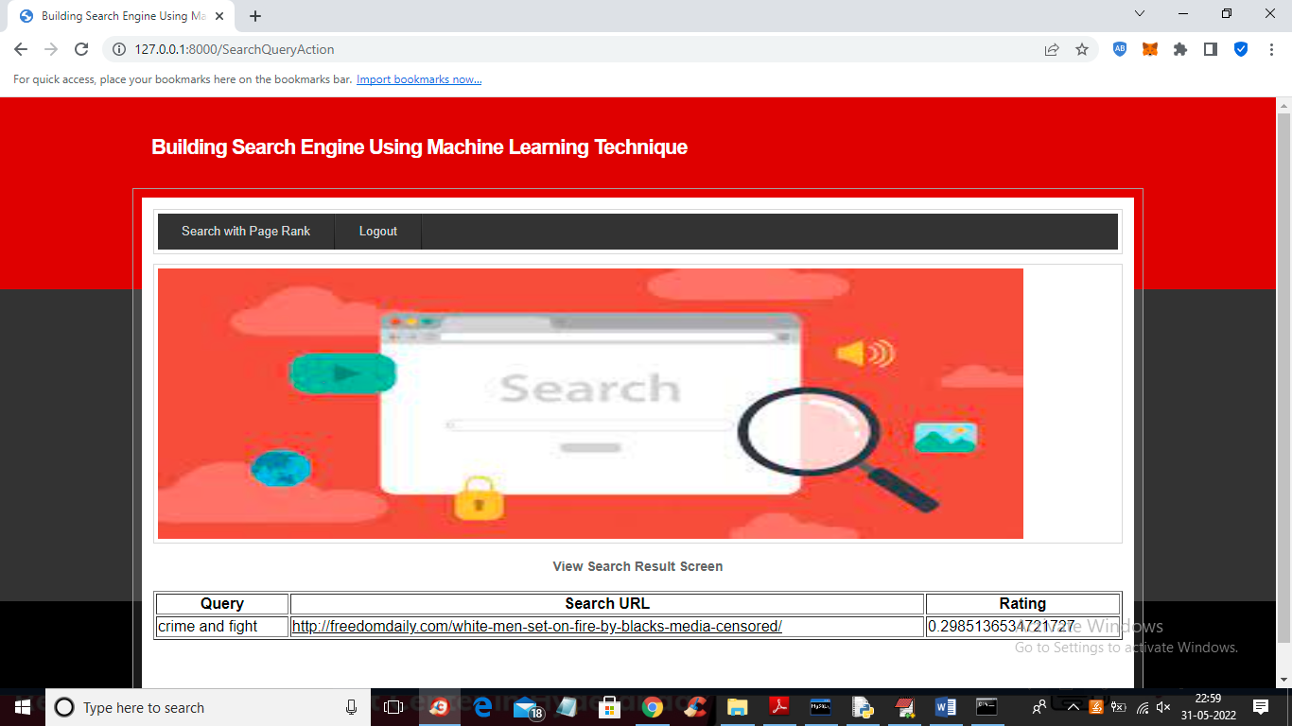
OUTPUT SCREENS
VIEW SEARCH RESULT SCREEN
Fig: View Search Result Screen

Slide 17
CONCLUSION
Search engines are very useful for finding out more relevant URLs for given keywords. Due to this, user time is reduced for searching the relevant web page. For this, Accuracy is a very important factor. From the above observation, it can be concluded that XGBoost is better in terms of accuracy than SVM and ANN. Thus, Search engines built using XGBoost and PageRank algorithms will give better accuracy.

Slide 18
THANK YOU

